Slide 1

Onboarding Agile & Frameworks
Montrium

Slide 2
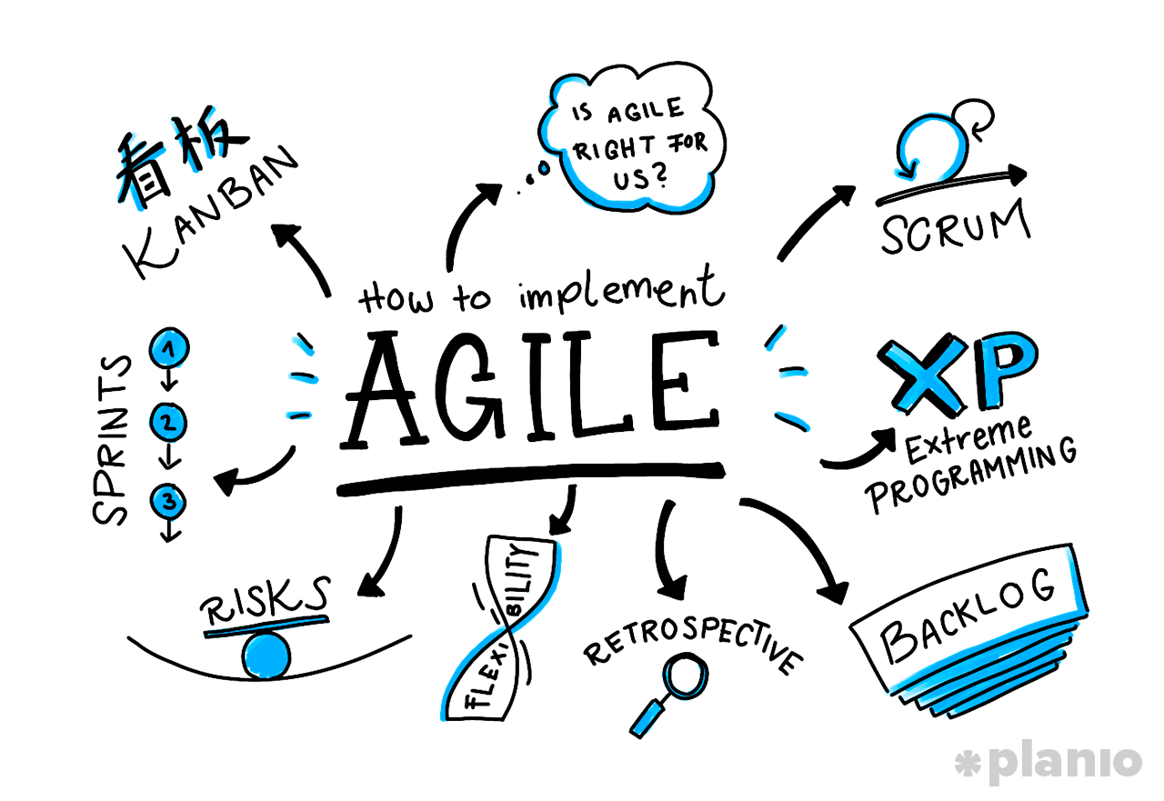
Agenda
Introduction: Agile
Framework: Scrum
Framework: Kanban
Agile tools
Our Evolution

Slide 3
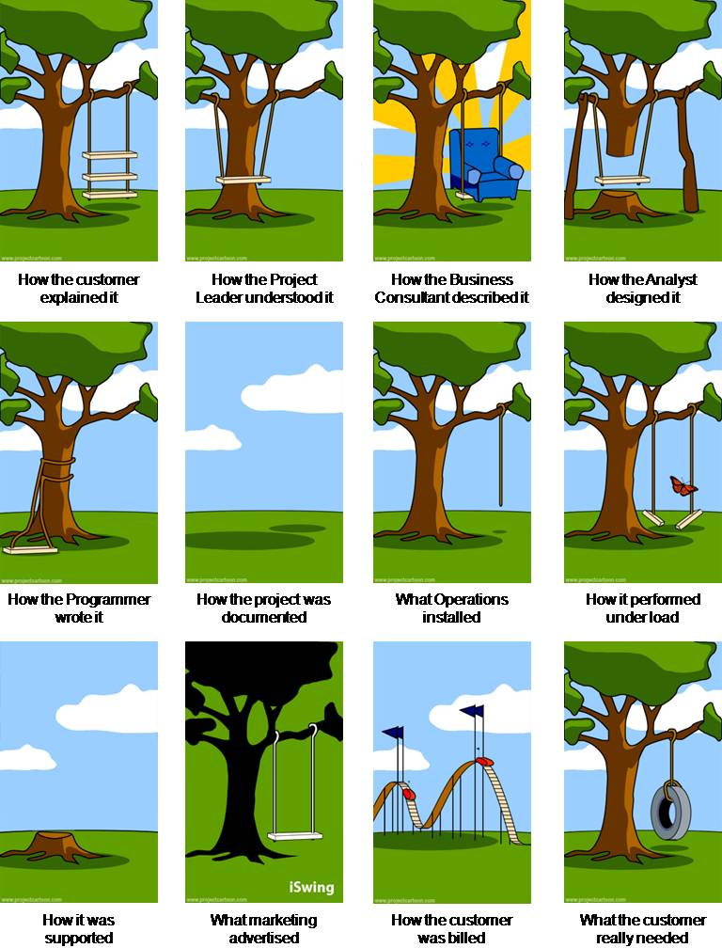
Why “Agile”?
Any project can experience the kind of strange situation where in the end, each stakeholder has a different understanding of the delivery.
Regardless of the framework used, this can easily and quickly happen without good coordination and communication between the participants.
Agile does not pretend to solve all the issues but works to improve the cycle of interaction and feedback between the parties.
Everything is about the mindset, the values, and how to use the frameworks.

Slide 4
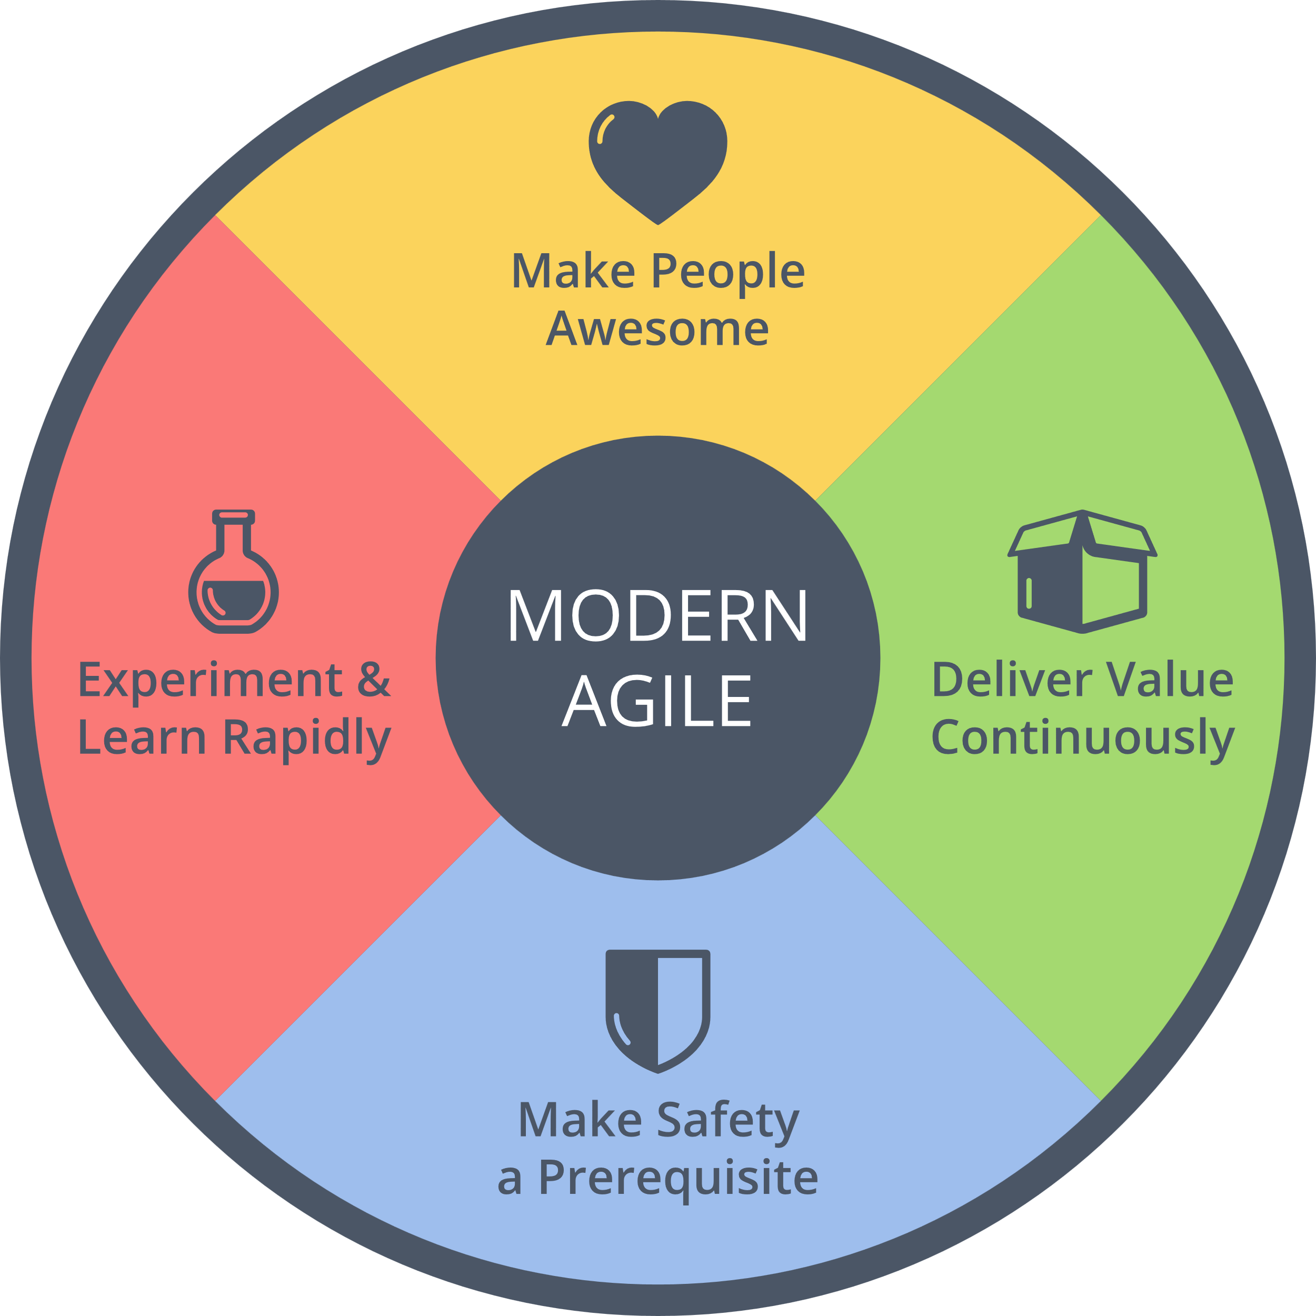
Principles
Agile focuses on:
quick increments to deliver regularly to easily collect feedback and suggestions
quality over quantity to manage and understand what people are trying to build
clarify the responsibilities of each partner to move forward on the right track.
Agile is a lightweight method centered on people and communication.

Slide 5
Values
I care about the progress of my peers during the Sprint to unlock them (autonomy, knowledge sharing, etc.),
I share my progress and my needs to my teammates by updating my tasks daily,
I focus on closing active works rather than opening new items,
If my priorities or planned activities are unclear, I open this topic to the team and my PO.

Slide 6
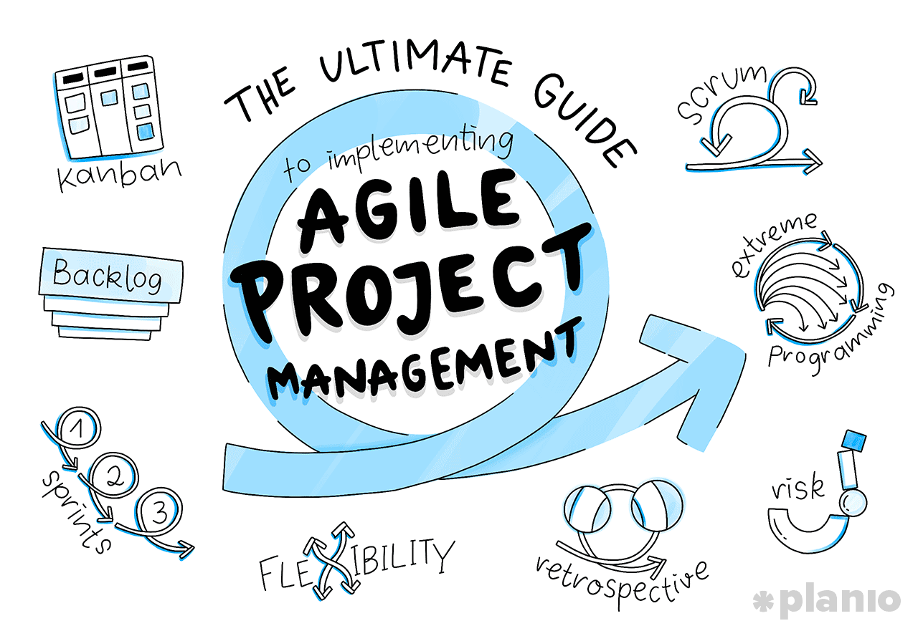
Agility is an attitude, not a technique with limits. An attitude has no limits.
Alistair Cockburn, co-author of Agile Manifest

Slide 7
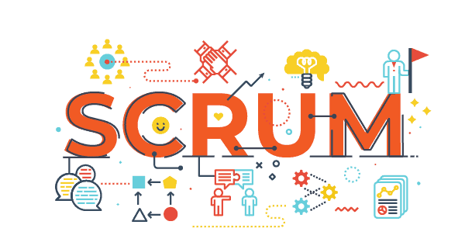
Scrum
What it is
How it works

Slide 8
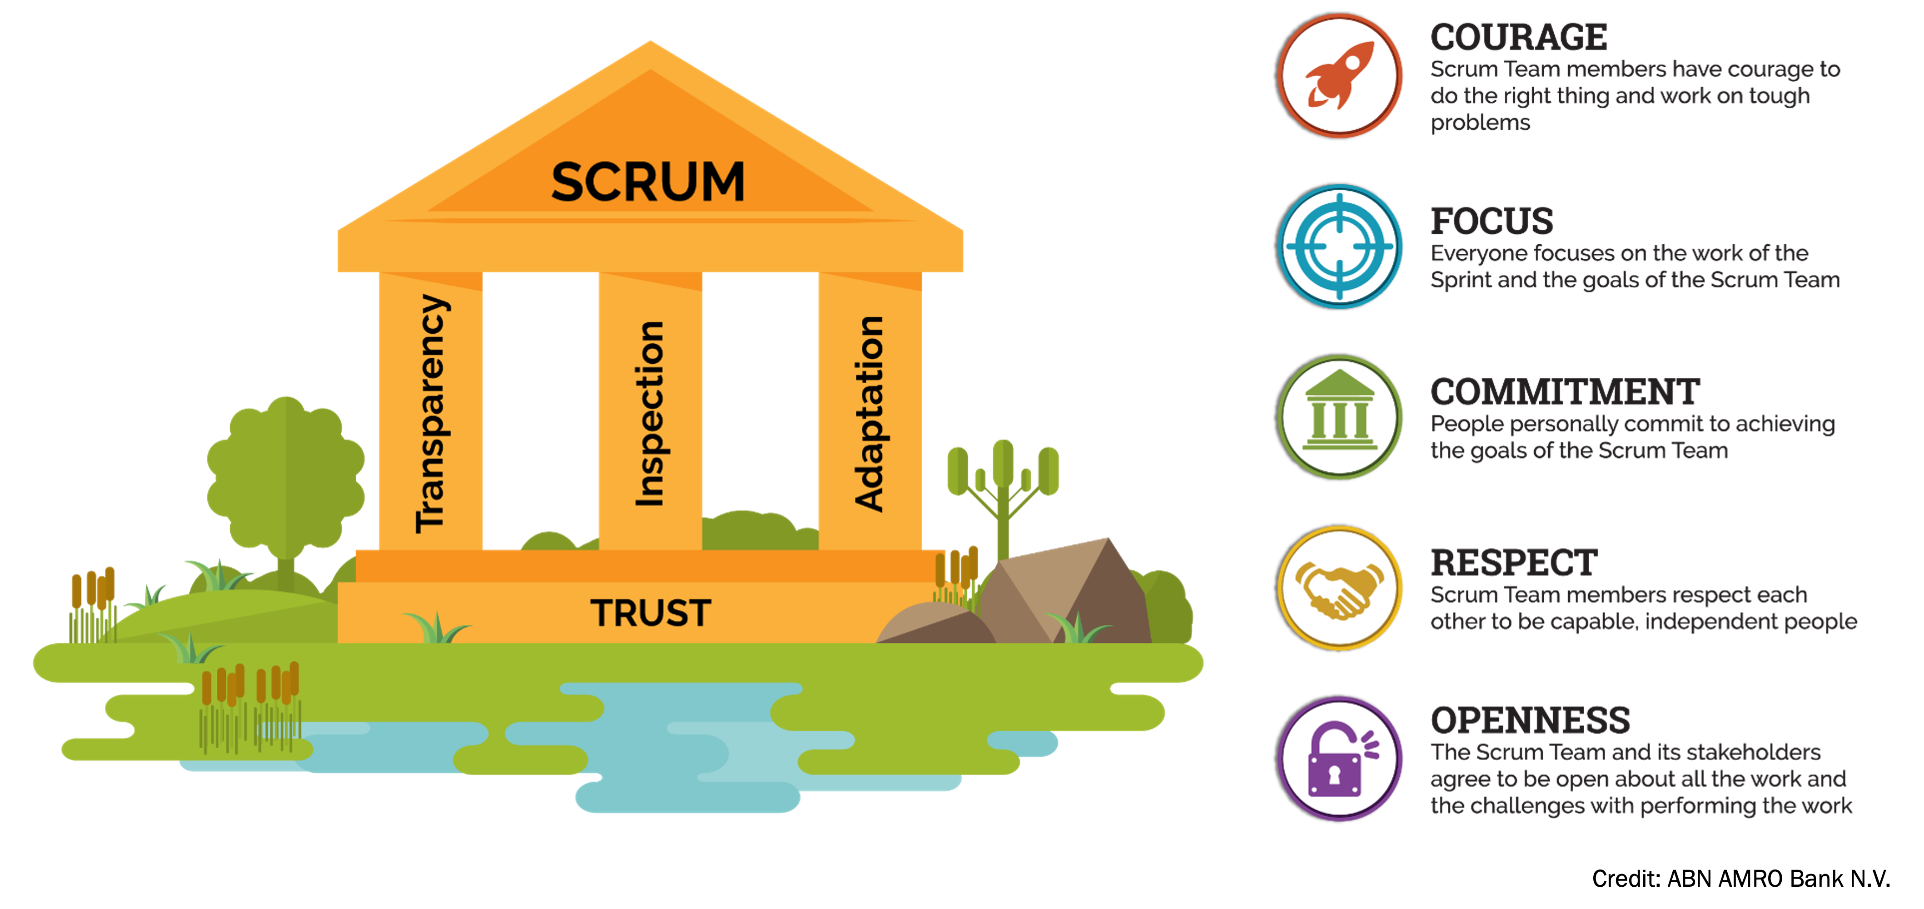
Principles & Values
Notes:
It's not always easy to gradually trust your teammates (it takes time and "proof" to build this relationship). This mutual trust is based on the transparency of actions and the honesty of exchanges.
But if the team does not trust each other, it will never be able to really feel efficient. A breach of trust is the hardest thing a member can experience.

Slide 9
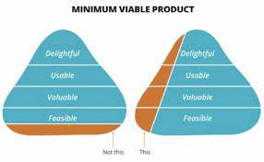
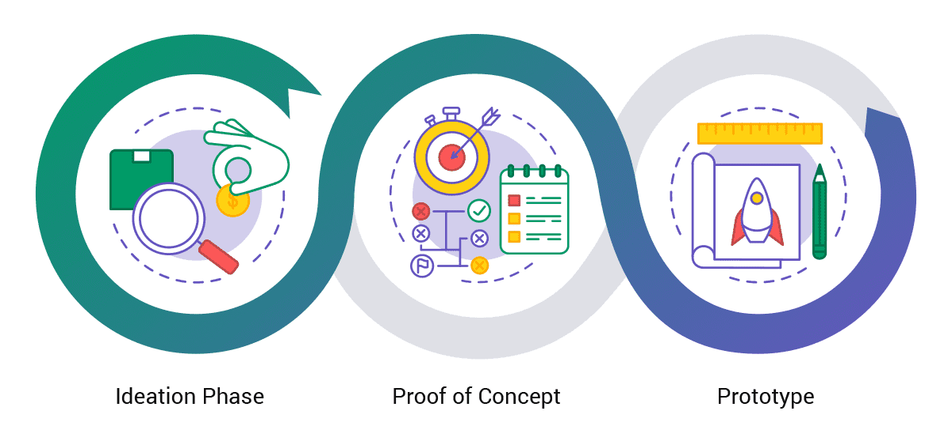
Concepts: SPIKE, POC & MVP
A Spike is a reconnaissance mission. The objective is to take something that you know almost nothing about (like using a new technology or language) and getting enough information about that thing to make planning more predictable.
A Proof-of-concept (POC) is another activity to gain greater understanding. However, whereas a spike is about understanding the complexity of something you have to do, a POC is about evaluating whether an idea is worth pursuing.
MVP has just those features considered sufficient for it to be of value to customers and allow for it to be shipped or sold to early adopters. Customer feedback will inform future development of the product.

Slide 10
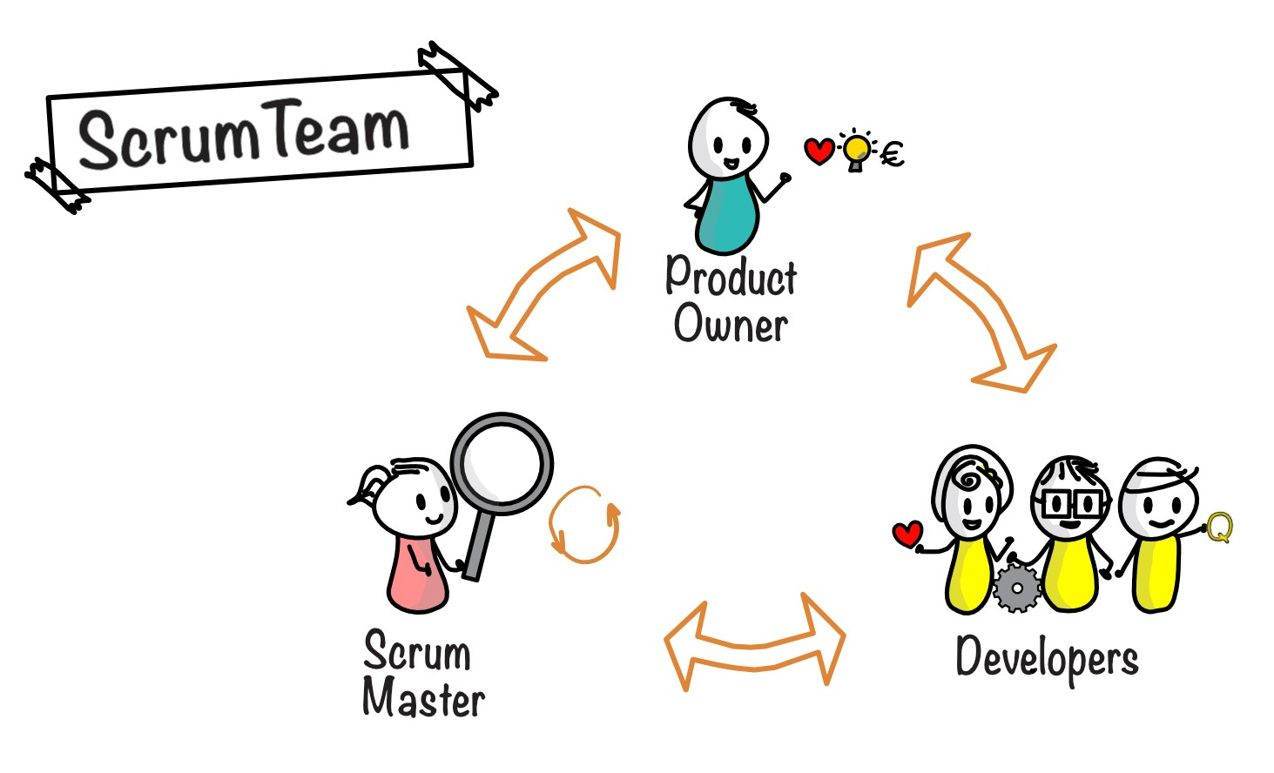
Roles & Responsibilities
Product Owner (PO)
is accountable for maximizing the value of the product resulting from the work of his/her team,
is accountable for effective Product Backlog management (priorities, missions' clarity, Sprint goal definition, etc.),
may delegate some responsibilities to others but always remains accountable (based on the team maturity).
Developers
are committed to creating any aspect of a usable increment each Sprint,
are accountable for:
Creating a plan for the Sprint,
Instilling quality by adhering to a Definition of Done (DoD),
Adapting their plan each day toward the Sprint Goal,
Supporting each other accountable
Agilist (SM/AC)
is accountable for establishing Scrum practices
is accountable for the Team’s effectiveness by enabling the members to improve its practices
serves the Team to remove any organizational blocker

Slide 11
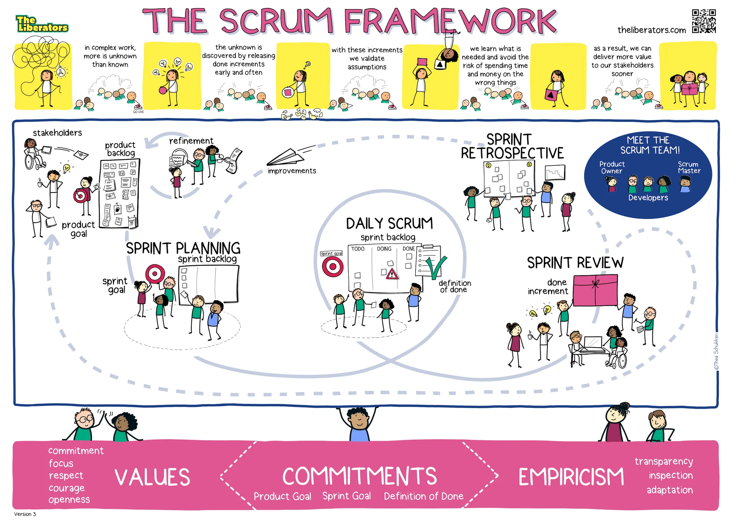

Slide 12
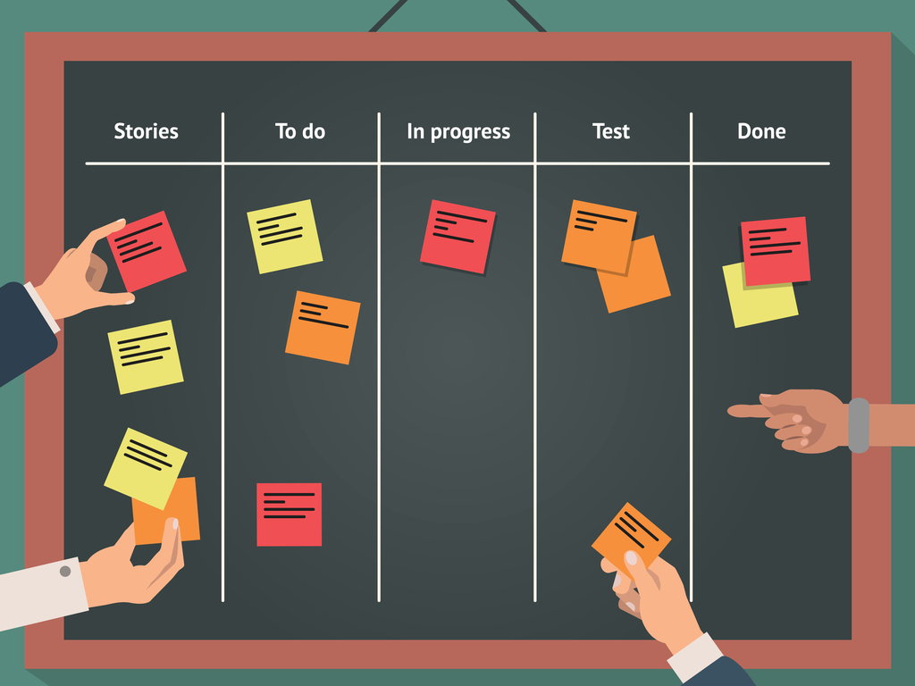
KANBAN
What it is
How it works

Slide 13
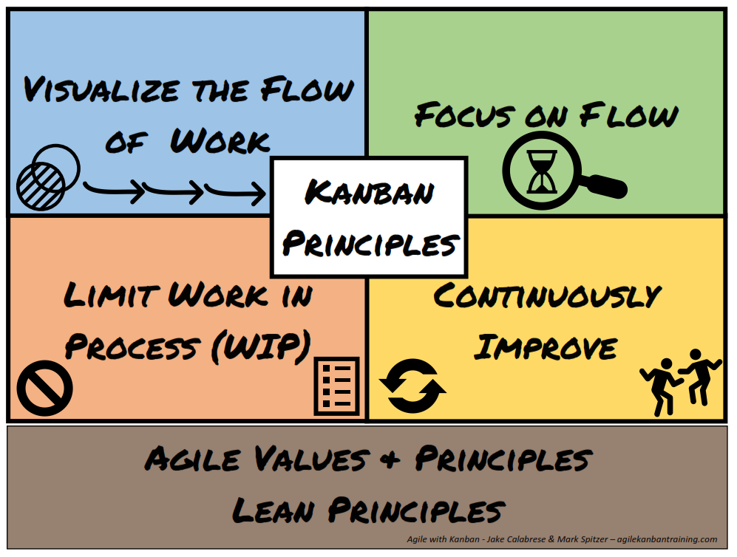
Principles & Values
Kanban is another framework more suitable when the main goal of the team is to focus on "JUST IN TIME“ (JIT) actions.
To perform well, it is very important to be aware of the concept of limit Work in Progress (WIP).
All is about “triage”: the team ability to start & stop a work depending on the learning, the internal team milestones, and the potential new priorities.
Kanban is a continuous process (where Scrum is an incremental process).

Slide 14
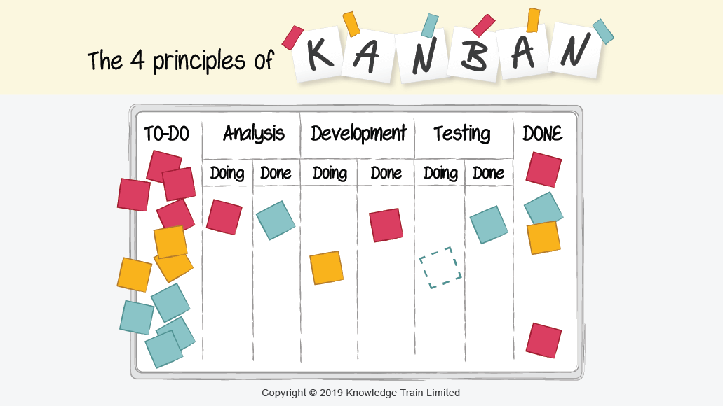
Team Milestones
At each stage, the team must be able to quickly make a decision (start, stop, continue).
Pick a work item based on its criticality (priority and severity) and your skills,
Perform a rapid analysis to get enough information to adjust priority and predictability (projected working time),
Request a team code review to optimize your work and confirm the resolution of the request,
Deliver and secure the final work by linking it to a future release.
Items are “pulled” directly from the backlog and not “pushed”.
The clarity of the Sprint backlog cards is essential (information provided justifying the criticality)

Slide 15
Roles & Responsibilities
Kanban Team
Product Owner (PO)
is accountable for maximizing the value of the product resulting from the work of his/her team,
is accountable for effective Product Backlog management (priorities),
may delegate some responsibilities to others but always remains accountable (based on the team maturity).
Developers
are committed to creating any aspect of a usable increment each Sprint,
are accountable for:
Closing a work item or a specific task,
Respecting the quality flow and practices at each step of the progression,
Adapting their plan as soon as a new top priority is brought by the PO,
Supporting each other accountable
Agilist (SM/AC)
is accountable for establishing Kanban practices
is accountable for the Team’s effectiveness by enabling the members to improve its practices
serves the Team to remove any organizational blocker

Slide 16
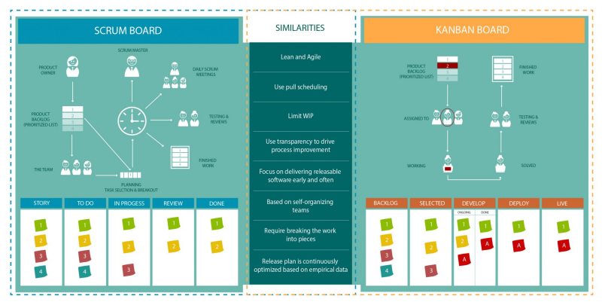

Slide 17
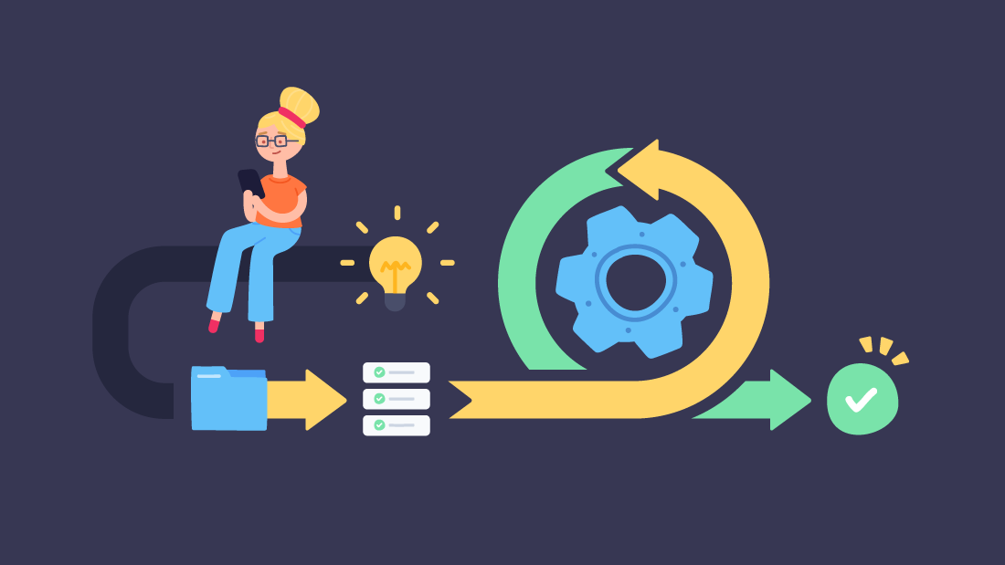
Agile Tools
What it is
How it works

Slide 18
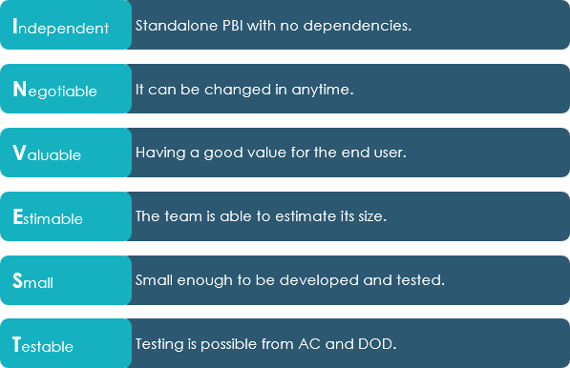
Definition of Ready (DoR)
Foundations:
Grooming helps me understand purpose and clarify scope for each User/Tech Story.
Grooming is a team conversation to sort out ideas, share knowledge, and be prepared for future work.
Planning helps me estimate the feasibility of delivering items through the new Sprint.
Planning is a team commitment to deliver specific functional work that provides defined value.
Planning helps me understand the Sprint goal(s) and my priorities.
Design Plan helps me to identify and clarify the technical implementation to reach the goal.
Design plan is a team collaboration to deliver the ideal solution (within time and technical constraints),
Tasking is how you represents this implementation work (sequence of important actions to do).
Squads share the same foundations. However, each Squad may have specifics team rules depending on their progression.

Slide 19
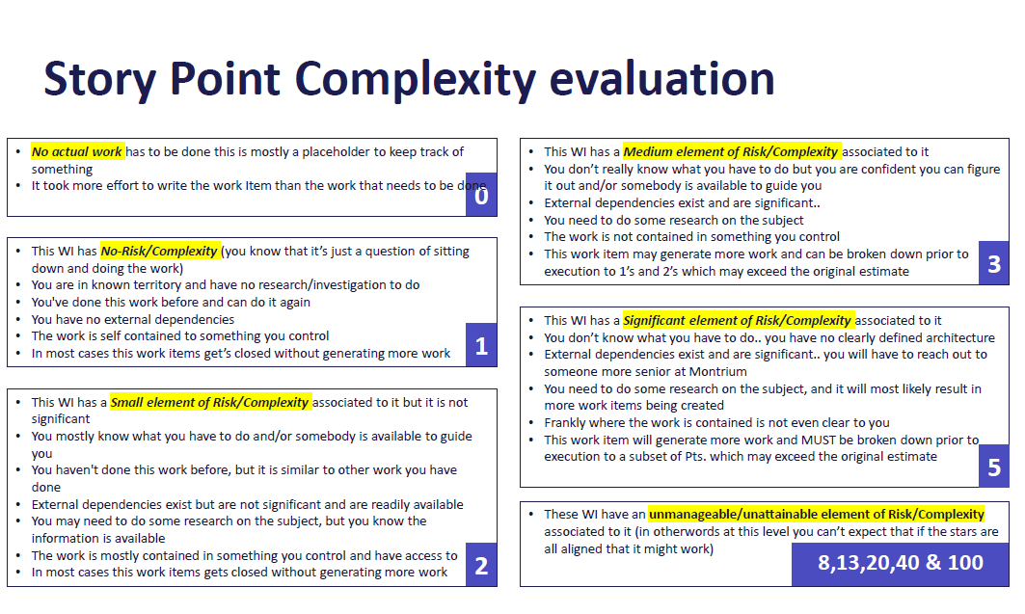
Definition of Done (DoD)
Size helps teammates explore a User Story by sharing our technical understanding.
If we have a [5], we need to decide what is the best delivering approach: a prior "Spike"? a division of the User Story to reduce its scope?
Simplifying a problem is a recommended approach to implement, test, and learn faster and easier.
Reminder: there is no direct relationship between size and time. Something with no unknowns can still take time to be implemented well.
Code Review helps teammates acquire technical skills and identify gray areas not initially planned.
The technical solution works well, the test coverage is validated, and the User Story objective is achieved.
The team can explain/describe the initial need and the result obtained or show the deliverables to external members.
Complexity ≠ Complication (but sometimes, a system can be both)
Notes:
Complexity refers to something that is made up of many interconnected parts. Complex systems, such as living organisms or societies, are difficult to understand or predict because they are made up of many interacting and different parts.
Complication refers to the addition of foreign elements to a system, which makes it harder to understand, use or navigate. Complicated systems are not necessarily complex, but they often are by the presence of useless or redundant elements.
The main difference between complexity and complication is that complex systems do not have definite solutions (make Spike/PoC) unlike complicated systems which can be simplified by removing unnecessary elements or reducing the system to its essential components (split the works).
When engaging in conversation about any topic, it is important to first ask the question of whether the issue at hand is complex or complicated. This will help to determine the best approach for understanding and addressing the problem. For complex systems, a holistic and interdisciplinary approach is often necessary. For complicated systems, simplification and reduction may be the best approach.

Slide 20
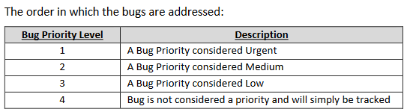
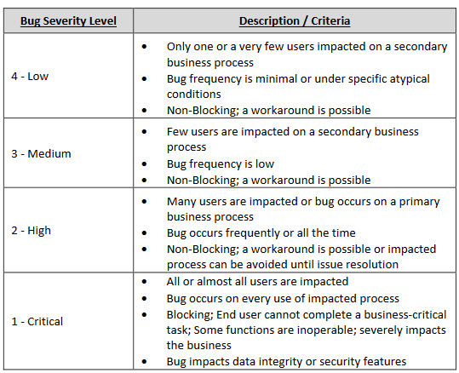
Criticality = Priority + Severity
Any item has the concept of criticality whatever the framework used and the scope (feature, user story, bug, issue, tasks).
Priority is a key concept based on direct input from our users and our appreciation of situations (value, pertinence, etc.).
Severity is a key concept based on the direct impact experienced by users, our platform/solution.
Regular work items are not “critical”, but they always bring explicit values (new or added)

Slide 21

Our evolution
What we aim for

Slide 22
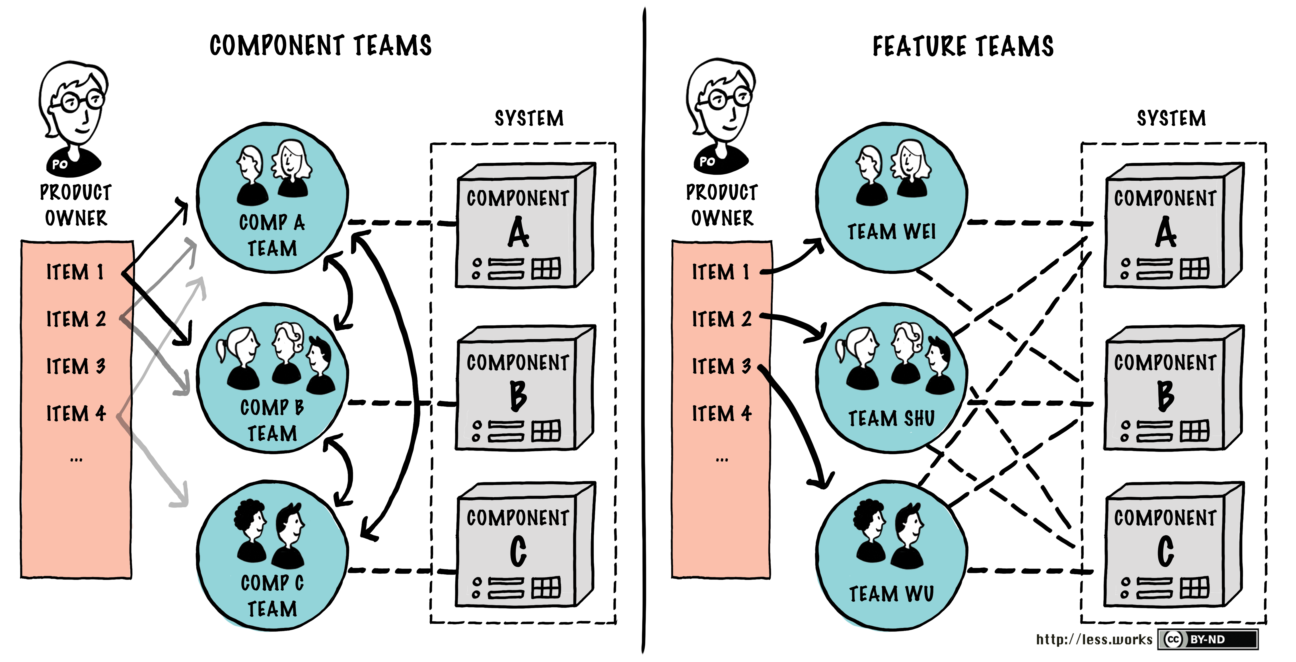
Self-sufficient Squads
Since 2018, our actions go in the same direction:
Each Squad can work on any part of our solution (Connect),
Each Squad can suggest/recommend improvements to their PO,
Each Squad can take time to improve their skills (self-training, formation, etc.),
Each Squad is aware of our implementation choices to control technical debt.
Squads aren't just “do-ers". We see them as true internal partners to help Montrium focus and deliver the best solutions.

Slide 23
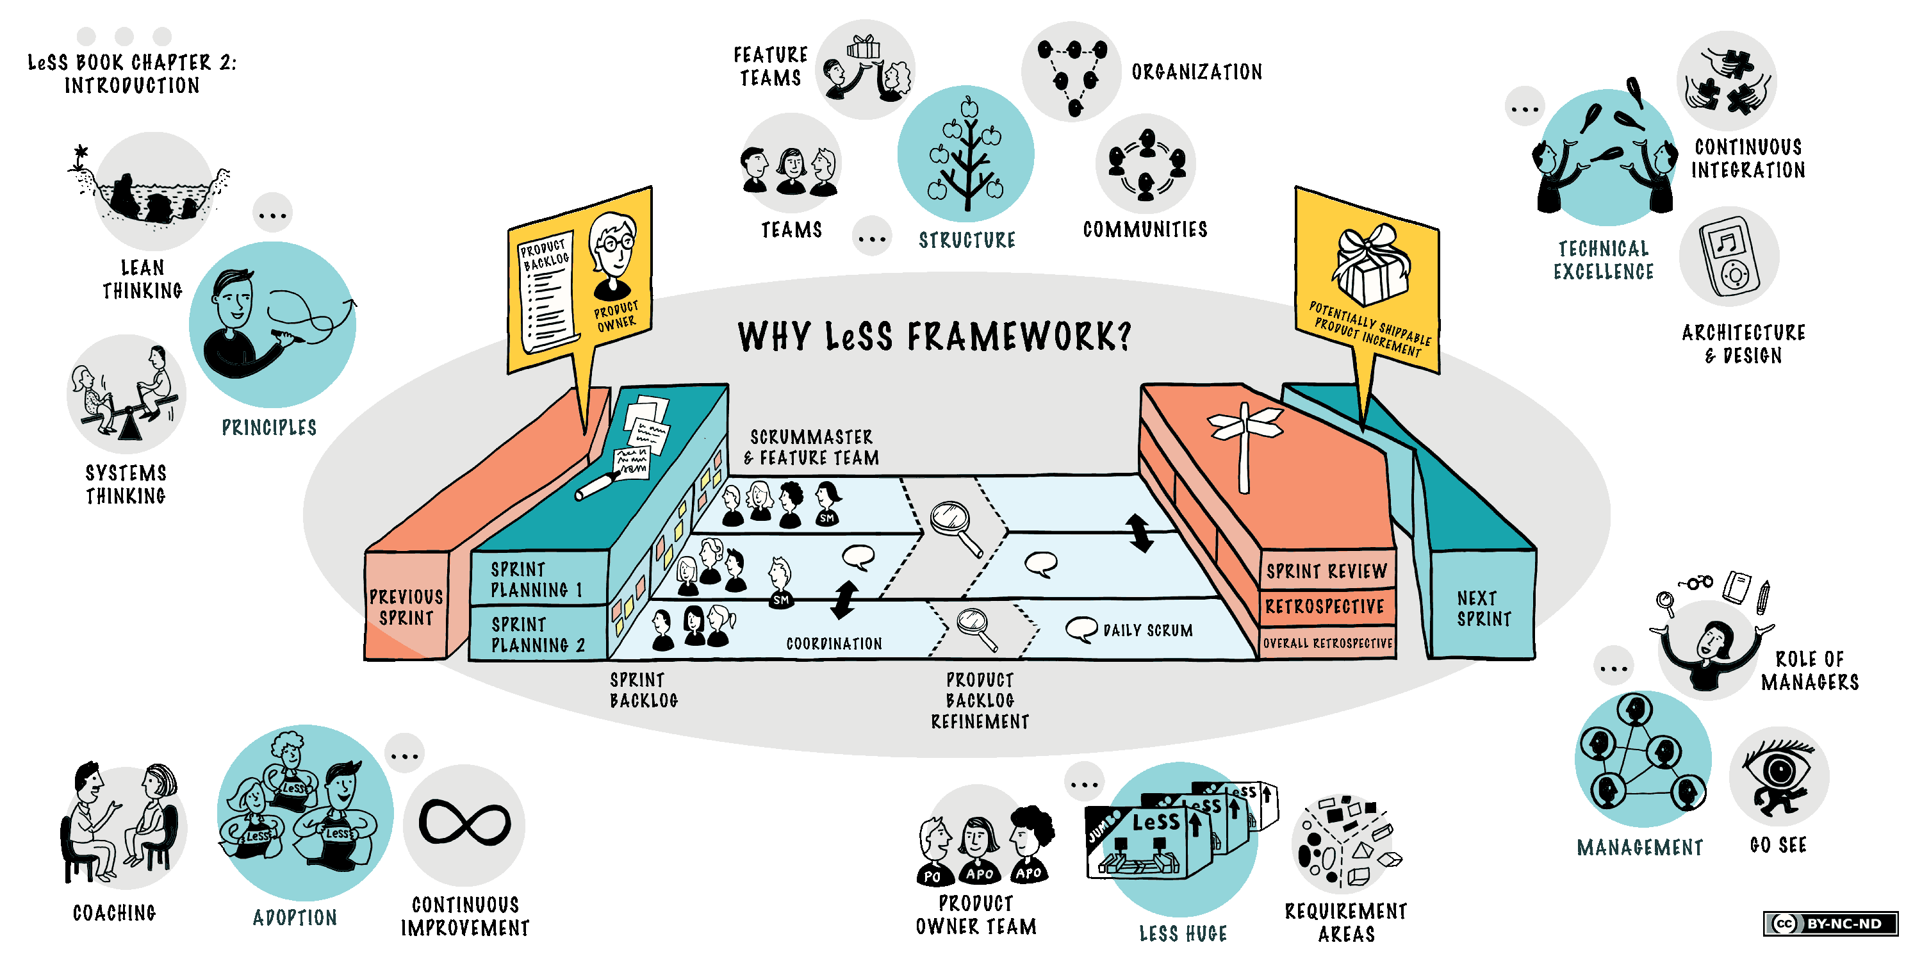
Mature organization to support everyone
Having clear direction (goals) helps everyone stay focused on the right initiatives. The roadmap represents this vision and evolves in parallel.
To support this, official teams and organic working groups coexist to share their knowledge and help each other make the best decisions.
This synergy also allows members to shine outside their main group.

Slide 24
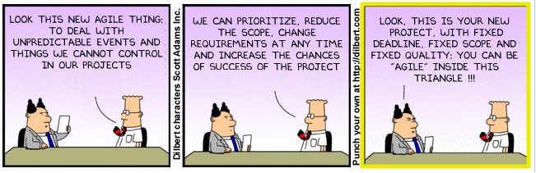
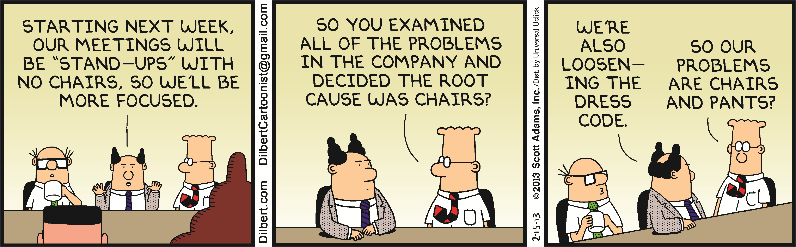
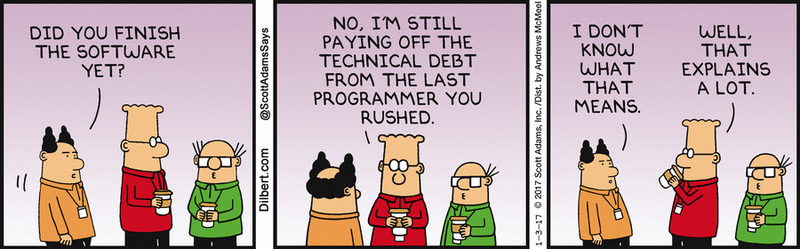
Questions & Feedback

